Slide 1
Asthma and Air Pollutants in The Bronx
Zulnorain Ahmed
GEOG331: Environmental Data Science
Professor Loranty

Slide 2
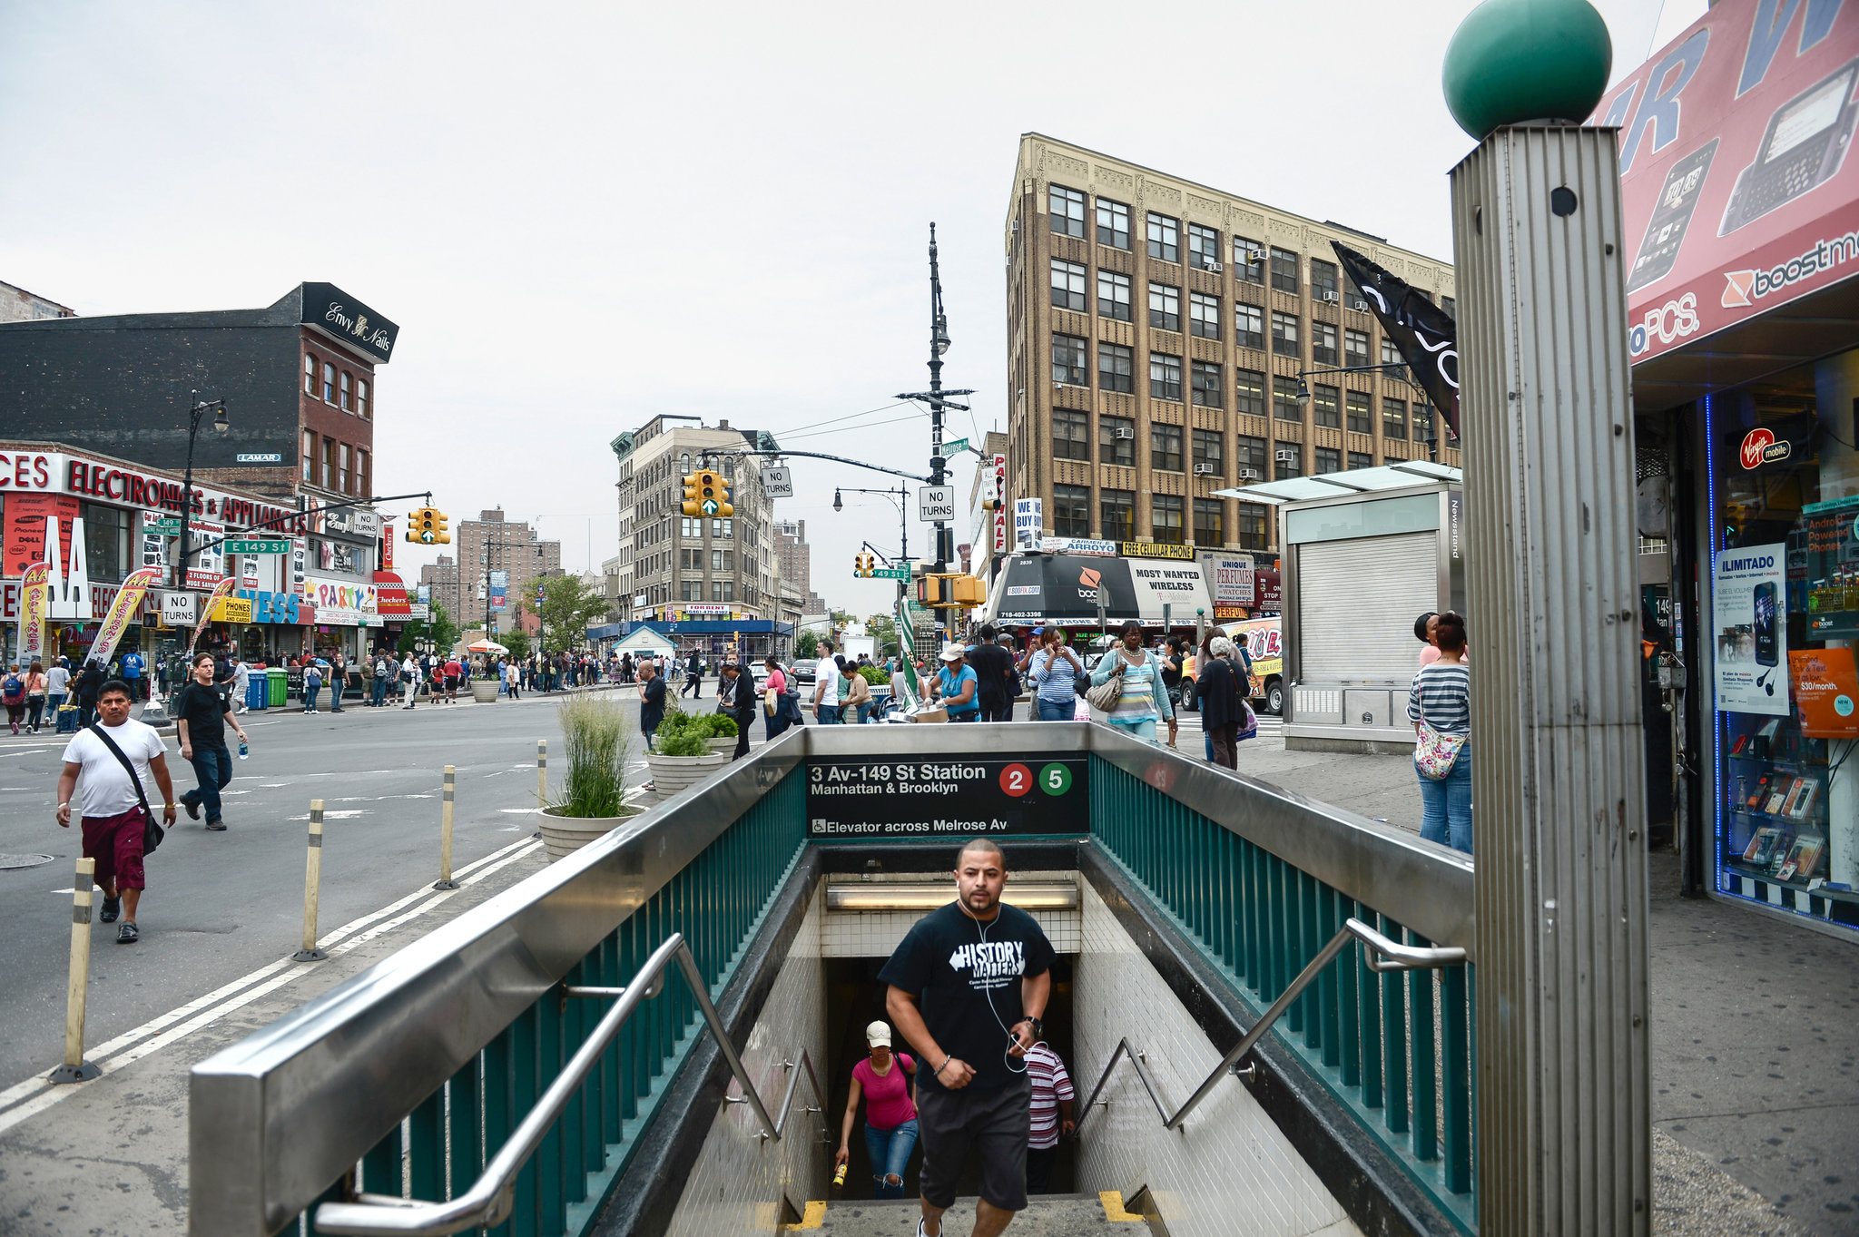
Research Question
How does air pollution in the Bronx affect asthma rates of its citizens?
[1]

Slide 3
Background
[6]
Fine Particulate Matter (PM2.5)
Fine particles are released by automobiles, building boilers, and other forms of combustion, and are a major source of air pollution that impacts human health.
Nitrogen Dioxide (NO2)
produced by combustion that can harm lung tissue.
Sulfur Dioxide (SO2)
Comes from burning certain types of fuel oil.
Ozone (O3):
Common air pollutant that develops in the atmosphere from gases that come out of tailpipes, smokestacks and many other sources.

Slide 4
Variables Tested
Preventable Asthma Hospitalizations
Asthma Emergency Department Visits
Air Pollutants
PM2.5 (Particulate Matter)
NO2 (Nitrogen Dioxide)
O3 (Ozone)
SO2 (Sulfur Dioxide)

Slide 5
Methods and Data
NTA-health dataset for 2018 for R analysis
NYC-Open Health Dataset for website Python analysis
Spatial Analysis
I made multiple choropleth map and combined geospatial boundaries with geospatial data from the two datasets above
Pie Chart
Calculate percentage of pollutants

Slide 6
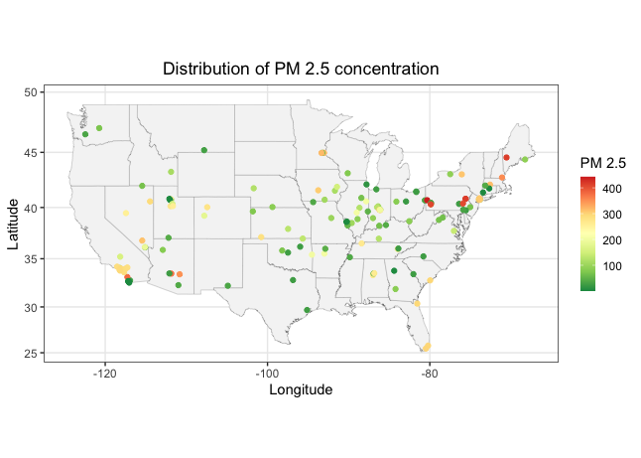
Preface

Slide 7
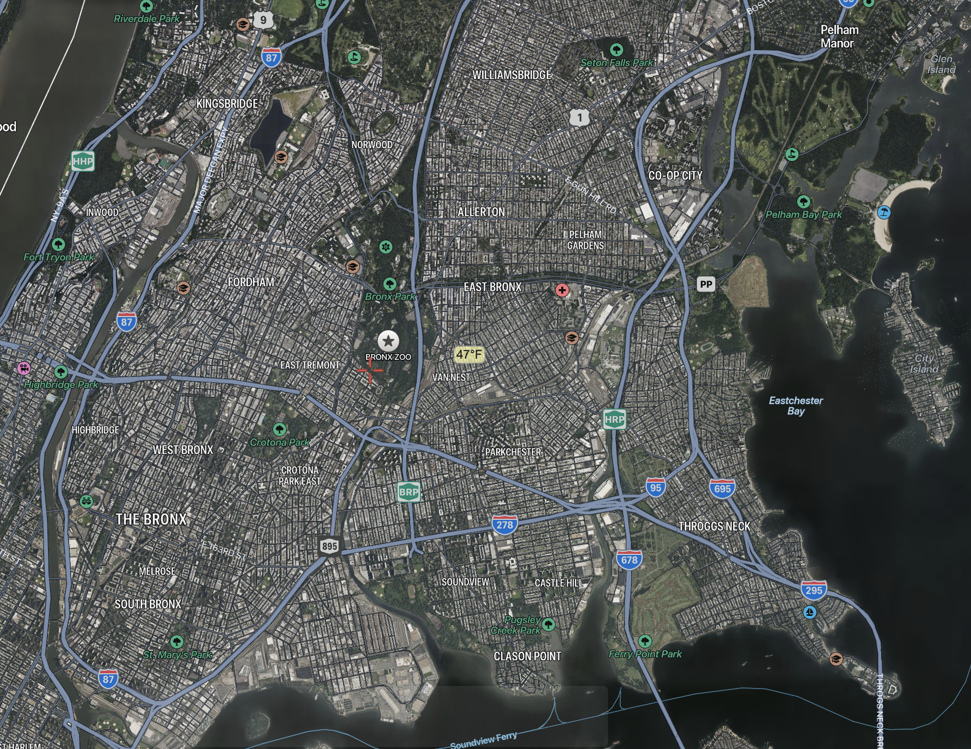
[4]

Slide 8
Small Website/App to visualize data
Hosted with Streamlit.io
Made with Python
Choropleth map
Visualizes Asthma Emergency Dep. Visits
Visualizes Mean pollutant values
Pie chart
Percentage of Pollutants
https://share.streamlit.io/zahmed333/bronx-pollution-asthma-analysis/main/streamlitapp.py

Slide 9
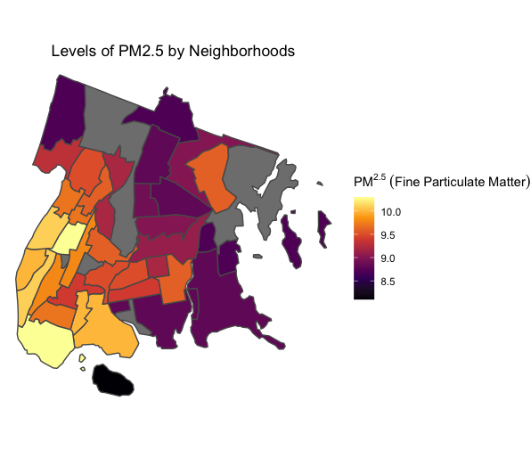
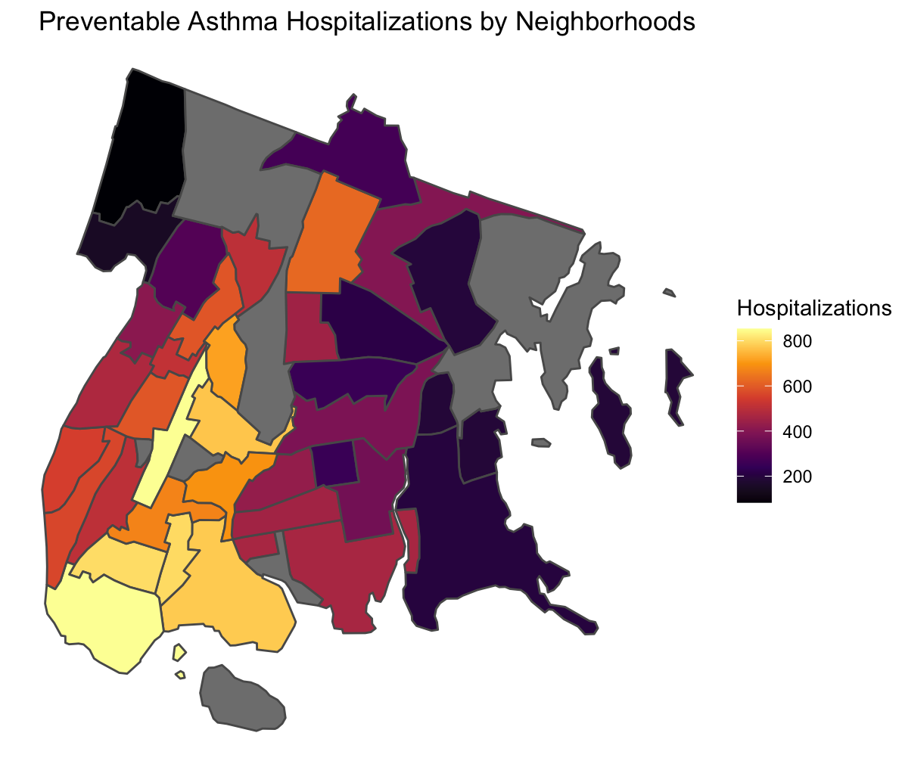
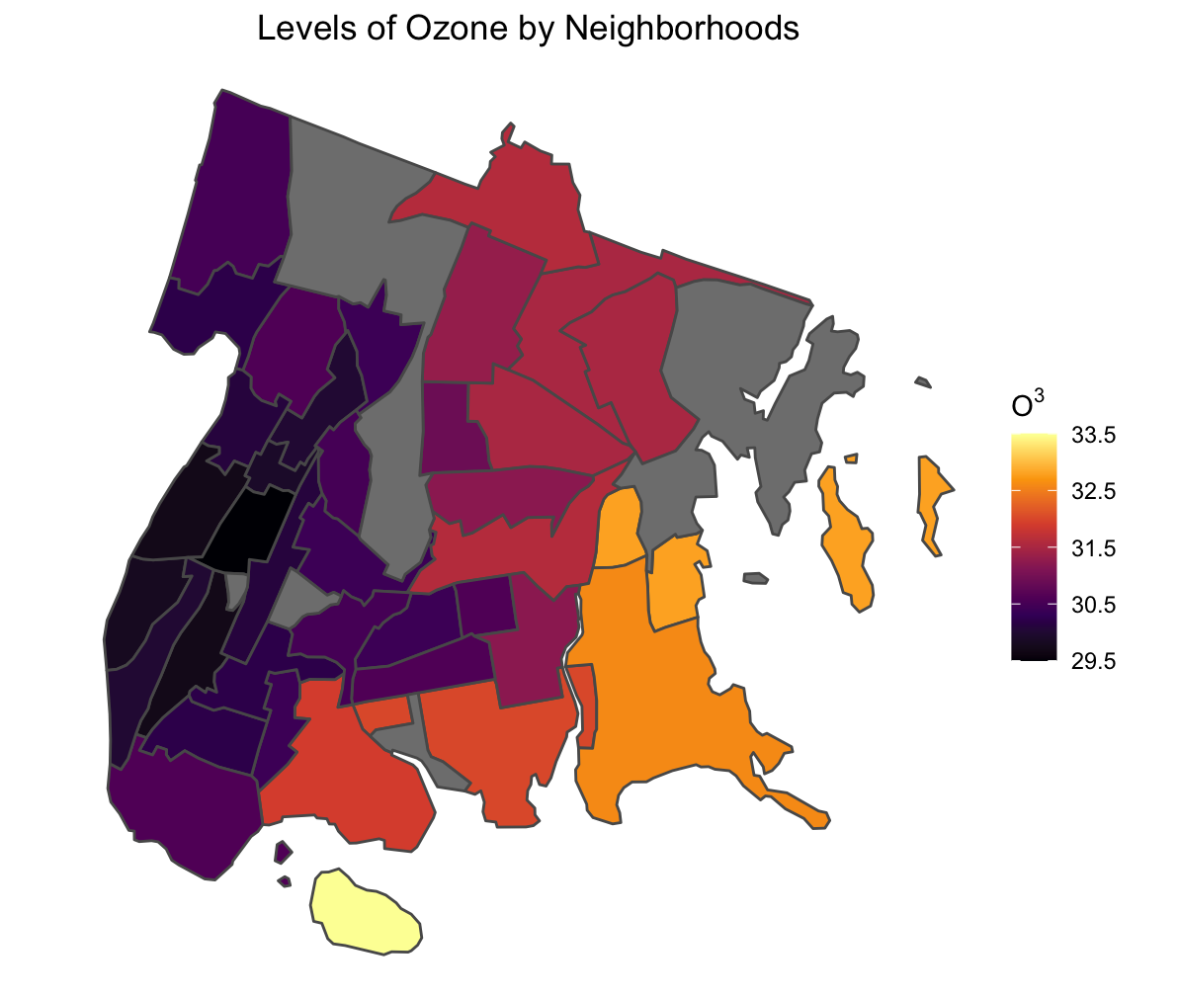

Slide 10
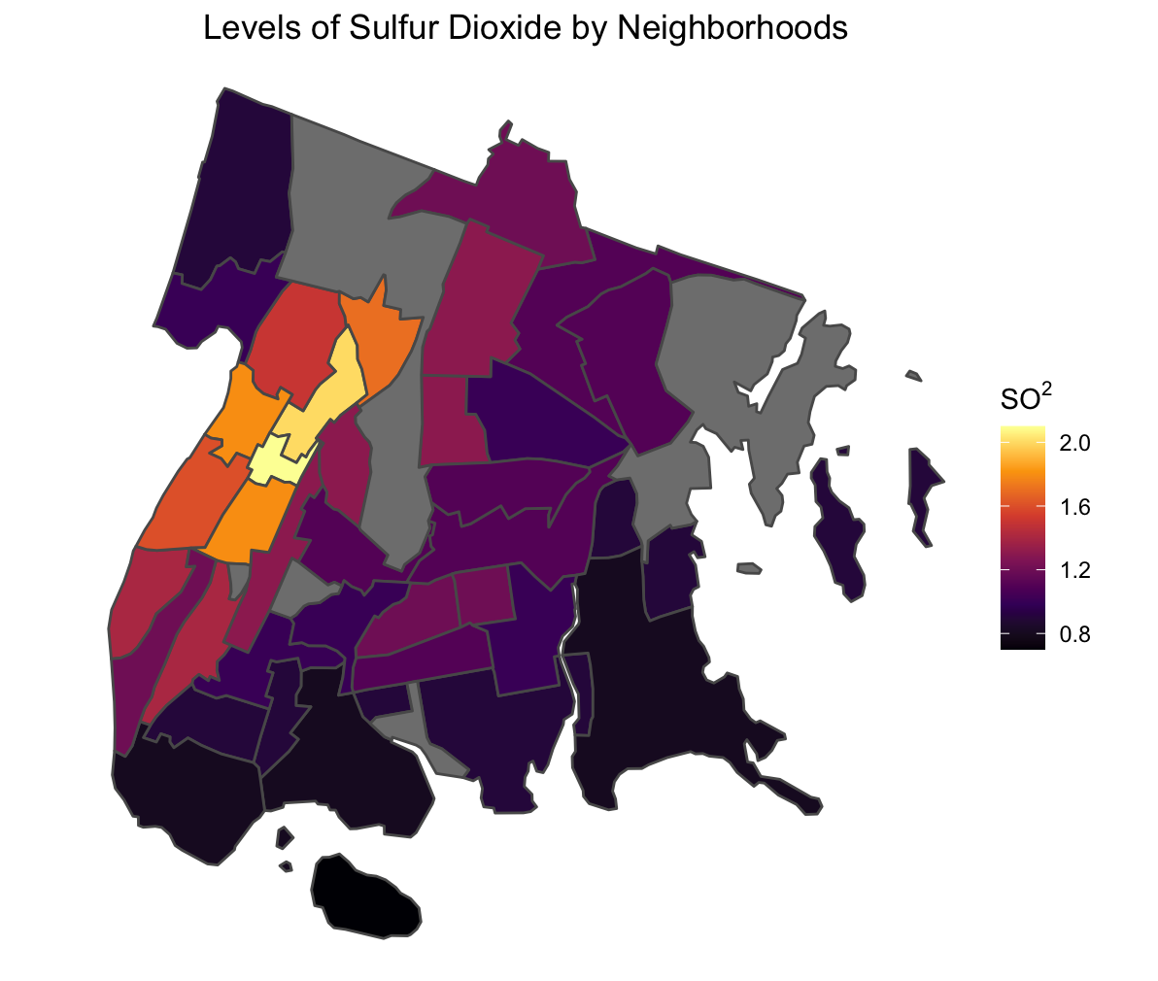
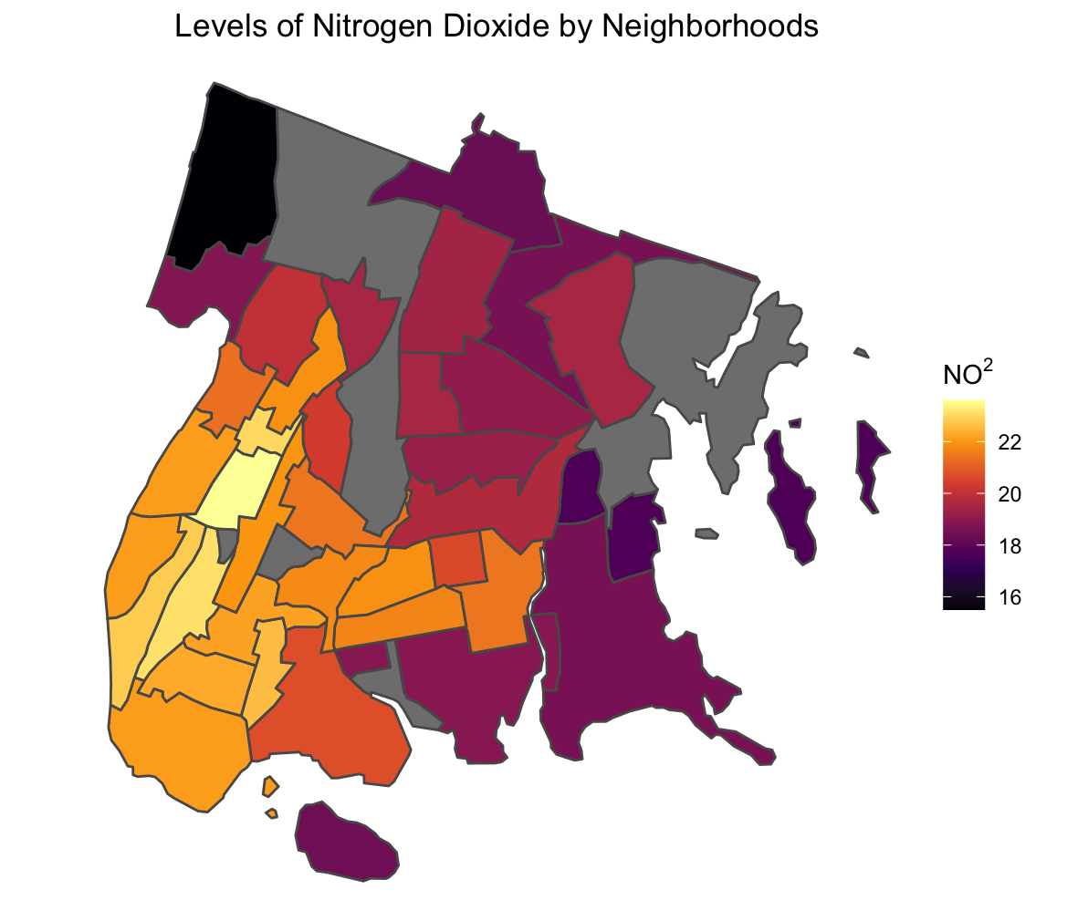

Slide 11
Conclusions
Air pollutants come together to increase asthma hospitalizations and even create a death rate.
Evidence suggests that the reason for a death rate is because the only time people get treated for asthma is often in the emergency room. (Warman et al, 2009)
There lies a correlation with the amount of hospitalizations and air pollutants within an area.
This remains true with every air pollutant analyzed except for Sulfur Dioxide and Ozone which has higher recordings in West Bronx rather than the south

Slide 12
Why does this matter?
“The color of your skin and your economic status should not determine the quality of the air you breathe.” - Mychal Johnson [2]
The Bronx is a low income neighborhood and creates more obstacles for disadvantaged citizens
The money we spend in healthcare would be made back if the money went into improving the quality of life.
“Capping the Cross Bronx Expressway and filtering the air, even though it is quite expensive to do so, would pay for itself by reducing health costs in this region.” [2]

Slide 13
What has been done about the issue?
Bringing awareness to the issue
Environmental Justice Air Monitoring Act
“Fund a network of air monitors to understand the health risks of air pollution block by block.” [2]
South Bronx Unite
A popular Non-profit organization that organizes protests to raise awareness
Renovation
Governor Cuomo spent $75 million on the Sheridan Expressway project that gave greenspace back to the Bronx River. This also turned a highway into a pedestrian friendly boulevard. [3]

Slide 14
What can be done about the issue?
Better Monitoring
“Hyper-local air quality monitoring would enable communities like the Bronx to see air pollution more clearly to that we can solve the problem with a greater sense of urgency.” - Rep. Torres [2]
More green spaces
Vegetative barriers between traffic zones and the street.

Slide 15
Citations
Davidson, A. (2012, July 10). Why Can't the Bronx Be More Like Brooklyn? (Published 2012). The New York Times. Retrieved May 6, 2022, from https://www.nytimes.com/2012/07/15/magazine/bronx-economy.html
Bronx Gets Another Boost Toward a Clean Air Future | Columbia Public Health. (2022, April 25). Columbia University's Mailman School of Public Health. Retrieved May 12, 2022, from https://www.publichealth.columbia.edu/public-health-now/news/bronx-gets-another-boost-toward-clean-air-future
Sheridan Expressway's removal project is completed – Bronx Times. (2019, December 20). Bronx Times. https://www.bxtimes.com/sheridan-expressways-removal-project-is-completed/
https://satellites.pro/The_Bronx_map#40.846086,-73.879795,13
Warman, K., Silver, E. J., & Wood, P. R. (2009). Modifiable risk factors for asthma morbidity in Bronx versus other inner-city children. The Journal of asthma : official journal of the Association for the Care of Asthma, 46(10), 995–1000.
Air Pollution and Asthma | AAFA.org. (n.d.). Asthma and Allergy Foundation of America | AAFA. Retrieved May 12, 2022, from https://www.aafa.org/air-pollution-smog-asthma/

Slide 16
Questions?

